Slide 1
Group 7

Slide 2
Campaign: We are here to make things easy for you
This marketing campaign is to build on the re-branded image for Royal Canin.
Royal Canin is a caring, expert-backed and community-focused brand for millennial pet parents
Our campaign message is emphasised through the customer journey, "We are here to make things easy for you.”
We proactively seek these millennial pet owners with relevant and targeted search tactics and mobile-friendly experiences.
We engage them through their preferred medium like video sites, blogs and social media.
We create a community for them and by them, with entertainment and information for their desire to search and share their pets with others, through community group online, social media and mobile app.
To sustain momentum, we also invite our customers or partner with key influencers on social media to have them share their own stories on social media platforms to generate buzz.
Notes:
Speaker notes: Read the slide

Slide 3
Location, Time, Behaviour
Data Signals
Integrated Message to Millennial
Pet Owners
Digital channels: video sites, web blogs, social media, image sites, mobile apps
Micro Moments
See
Think
Do
Care
We send out our campaign message through the See-Think-Do-Care customer journey from the beginning to the end.
The curated messages on the relevant digital channels are aim to match the data signal sent at the micro moments, based on their contextual search pattern, and our programmatic strategy.
Contextual Search
Programmatic Strategy
Device-specific, keywords
Notes:
Speaker notes: Read the slide

Slide 4
THE CUSTOMER JOURNEY & OUR OVERALL APPROACH
 | SEE | THINK | DO | CARE
Customer Journey | Mica & Mark treat their pets like first kids | Mica & Mark treat their pets like first kids and are looking for pet food | Mica & Mark treat their pets like first kids and are going to buy pet food | Mica & Mark have purchased Royal Canin products at least once
Micro-moments | Wants to know how to take better care of their pets | Wants to know how to choose pet food | Wants to know where and how to buy pet food | Wants to offer a review and share their own stories
Major behavior | Browse websites, blogs, videos of pet experts and influencers on Youtube, Facebook | Search Detailed info about pet food, read reviews and ask their community | Intense Specific Search On product, discounts and location or pet e-commerce platforms | Post pictures and own reviews on their own social media or websites
What do we want to achieve? | Customers to see our brand message. Know that Royal Canin cares and are here to make things easier for pet owners | Customers to see our product message. Know that our products are scientific and specifically tailored for individual pets. | Customers to see our product message and know where to reach us. | Customers to become our advocates and amplify our brand and product message.
General approach | Build awareness by targeting affinity and lookalike audience to reach potential customers. Use a mix of short form videos, out-stream video ads and image ads |  | Increase conversion by targeting in-market audience and remarketing audience Use a mix of text, image and native ads

Slide 5
OUR CUSTOMER’S BRAND JOURNEY
Wants to know how to buy food for their new pet
BROWSE for pet care on internet, social media platform, video platform, mobile app
Land on a pet care video, blog, image and media ads
For video, a short form video before the video
See native ads or out-stream videos on the blog
SEE
At this stage, they should know our brand message and be interested to find out more.
Overall parameters
Choose channels and platforms relevant to our millennial audience
Prioritise mobile experience, as our users are mobile-first
Provide relevant information at the relevant time
Continue to SEARCH for more information
Click and enter Royal Canin’s site but may not purchase
See Royal Canin’s image, video and native ads
Land on expert blogs, tutorial videos, or review sites
SEARCH for info related to pet food
DO
At this stage, they should know our brand and product message and be interested to make a purchase.
THINK
See customized ads based on previous searches
See product promotions that will lead them to the ecommerce sites
Customer makes the purchase.
See suggested video ads
e.g. “I just purchased my pet food, what’s next?”
Revisit website for more informative content and leave a review
At this stage, they are satisfied with their purchase and would like to share about Royal Canin.
CARE
Notes:
Speaker Note:
This is how our customer’s journey may look at each of the See-Think-Do Care stages. With this customer journey map in mind, we propose the use of mobile, search, display and video ads and programmatic marketing strategies at each of the stages to promote brand awareness in the See and Think stages and customer acquisition in the do and care stages.

Slide 6


Mobile Analysis
Customer Mobile Journey
Speed | Mobile optimization | Seamless experience | Innovative | AMP | PWA | Native app
5.2 second (mid range speed for website) | Not optimize | Not responsive design | Not innovative, only contain blog type articles and updates | Doesn’t use AMP | Doesn’t use PWA | Current apps are too confusing to use and not applicable across other countries
Wants to know how to feed their new dog pet
Search
for pet advice on mobile
Land on
Royal Canin Website
Wants to know if there is any visual content to watch
Land on the Visual content Section of the website
Mobile Analysis
Mobile touchpoint for Search
Mobile touchpoint for Display and Video
From the analysis above, most of the findings shows that Royal Canin Singapore didn’t consider mobile experience for their users. This is a great opportunity for us to redesign and develop the mobile strategy plan.
Almost 72% of Royal Canin Singapore Website traffic comes from mobile and 28% from desktop. This shows how important it is to have a well planMobile experience for the consumers.
Read some review on the selected food
Land into the E-commerce page within the website
Click on the banner
Saw some advertisement banner at the side panel showing “Pet food”
Viewed a couple of videos
Mobile Analysis & Touchpoints
Mobile touchpoint for Programmatic
Decided to try one based on the review and video
Purchased
Revisit website for more informative content
72%
Customer Mobile Journey
https://developers.google.com/speed/pagespeed/insights/
https://search.google.com/test/amp
https://search.google.com/test/mobile-friendly
https://www.similarweb.com
Notes:
Speaker Note: Mobile Analysis -
From the analysis above, most of the findings shows that Royal Canin Singapore didn’t consider mobile experience for their users.
This is a great opportunity for us to redesign and develop the mobile strategy plan.
Almost 72% of Royal Canin Singapore Website traffic comes from mobile and 28% from desktop.
This shows how important it is to have a well plan mobile experience for the consumers.
Customer Mobile Journey –
As you can see from this Customer journey, a good mobile experience strategy does affect other strategy for example search, video and display & programmatic.

Slide 7
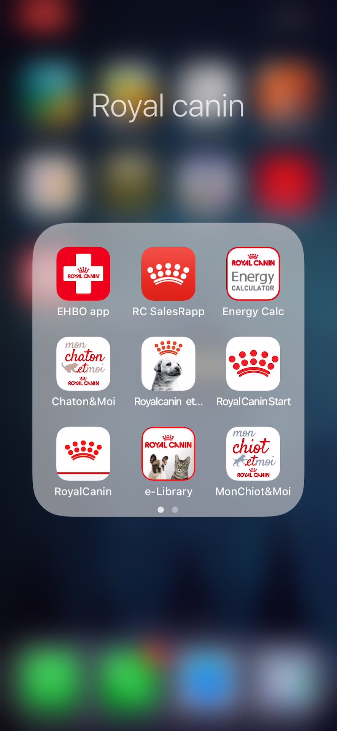
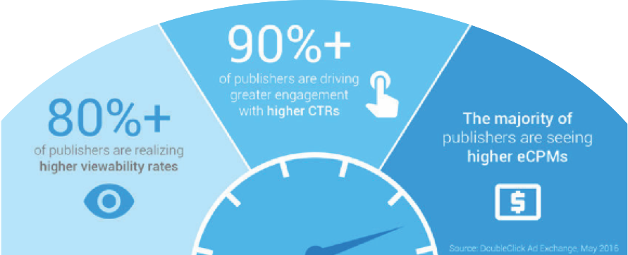
Mobile Experiences
Accelerated Mobile Pages
Native & Progressive Web Apps
Mobile Site Design
Mobile Experiences
PetHealth
Pet owners can have a videocall or chat with their neighbourhood veterinarian before they head down to the vet
With the inclusion of the native App call RoyalPetHub, we can utilize the features that a smartphone has.
We propose to include AMP due to the visual content that we have on our site eg. Videos, Visual Article pages, downloadable files etc. The current Royal Canin Sg site is not an AMP.
AMP can also indirectly influence where Google places pages in search results, according to Petty. If an AMP gets more clicks and fewer bounces because it's faster to load, Google determines that the page is valuable to users, and it's likely to get higher placement in search results.
"With mobile becoming more and more prevalent in just about every aspect of people's lives, and with the majority of people using Google to find just about everything, AMP will be an essential tool now and going forward to ensure good rankings and findability on the web," says Oleg Moskalensky, president of Productive Computer Systems
Speed matters. Especially on the mobile web.
Early results indicate better ad performance
on AMP pages.
We will include both PWA and Native App for our campaign. We would like to serve our users who are not interested in downloading and creating accounts in native apps, hence PWA is needed.
“If a company is dedicated and wants to get maximum engaged customers, the experience of a web app has to be close to that of the native app.” Progressive Web Apps match the mobile-first approach. This means that stores developed with PWA will function on mobile devices without any issues.
Native app is still still an advantageous solution, therefore we would also like to create an app to utilize the mobile features and functions for our users.
We would like to consolidate all apps
(shown in the short video) and merge
to one app call : “RoyalPetHub”
As shown in Mobile Analysis, there is a high percentage of mobile user visiting the royalcanin SG website therefore we have decided to redesign the current website to a Responsive website to cater to all devices used. Our 2 personas, Mica and Mark are both millennials. More than nine-in-ten Millennials (92%) own smartphones, compared with 85% of Gen Xers (those who turn ages 38 to 53 this year), 67% of Baby Boomers (ages 54 to 72) and 30% of the Silent Generation (ages 73 to 90), according to a new analysis of Pew Research Center data. Hence, a good mobile site makes it easy for our consumers to achieve their needs anytime and anywhere.
Benefits to our campaign:
Improved User Experience
Cater to Mobile Traffic
Faster Website Development
Easier Maintenance
Better Website Loading Times
Better SEO
Higher Conversion Rates
PetBuddy
Using the GPS or proximity function, pet owner can find other pets around their area to meet up.
PetCoach
Pet owner can now do a direct videocall to the next available Pet experts to get advice on training their pets
PetSafe
Using the sensors on our mobile, we can detect our pets location. This will be useful for the pet community in any case of lost pet or to update of any danger surroundings etc
Native & Progressive Web Apps
Features to include:
Standard pages eg Homepage, About us etc
Community Page
Visual Content Page
Ecommerce Page
Advertising (Programmatic)
PetAid
It aims to assist pet owner by using latest technology in VR. They can assess their pet through the eyes of technology
Mobile Strategy Plan
PeTube
A collection of videos be it for informative sharing within the pet community or just posting fun and memorable moments of their pets.
Accelerated Mobile Pages
PeTalk
Using the mic of your phone, you can record your pet voices and use our database to match the sound. Great insight to know your pet request.
PetChase
“Purchase” This feature includes E-commerce from the website. Users can read through comments and recommendation from their community to see what product is best for their pet.
PetResto
Find the nearest restaurant that serves pet food while you dine
Mobile Site Design
https://www.pewresearch.org/fact-tank/2018/05/02/millennials-stand-out-for-their-technology-use-but-older-generations-also-embrace-digital-life/
https://www.cio.com/article/3091071/8-things-you-need-to-know-about-google-amp.html
https://blog.bitsrc.io/what-is-a-pwa-and-why-should-you-care-388afb6c0bad
https://divante.co/blog/10-benefits-pwa-boost-your-business/
Click to Play
Notes:
Speaker Note:
Mobile Site Design: We will redesign the website to be responsive to cater for our high mobile users. As our 2 personas, Mica and Mark are both millennials.
More than nine-in-ten Millennials (92%) own smartphones, compared with 85% of Gen Xers, 67% of Baby Boomers and 30% of the Silent Generation.
Hence, a good mobile site makes it easy for our consumers to achieve their needs anytime and anywhere.
Accelerated Mobile Pages:
Speed matters. Especially on the mobile web.
Early results indicate better ad performance on AMP pages.
Native & Progressive Web Apps:
We would like to serve our users who are not interested in downloading and creating accounts in native apps, hence PWA is needed.
We would like to consolidate all apps as you can see from the short video and merge it to one universal app call : “RoyalPetHub”
Mobile Experience: To further extend the mobile experience through native app, we will include this features and services within the app. Just one download, to access all services. All at the touch of your fingertips.

Slide 8
Making it Easy for Pet Owners at Every Touch Point
Ad of Relevance for Royal Canin at each stage of customer journey
SEE
SEE
THINK
THINK
DO
DO
CARE
CARE
Keywords:
Pet fun
Small animals
Pet care
Pet entertainment
Keywords:
Best pet food
Quality pet food
Nutritional
Healthy
Keywords:
Royal Canin Singapore
Pet food
Specialised
Keywords:
Pet community
Pet care
Pet entertainment
Pet fun
Touchpoint
Mica & Mark treat their pets like their first kids.
Mica & Mark treat their pets like their first kids and are looking for pet food.
Mica & Mark treat their pets like their first kids and are in the final stage of purchasing pet food.
Mica & Mark treat their pets like their first kids and have purchased Royal Canin products at least once.
At home or cafes.
Search on laptop
or mobile.
At night and weekends; after work and at leisure.
At home or cafes.
Search on laptop or mobile.
At night and weekends; after work and at leisure.
At home, cafes.
At work or on-the-go.
More likely to search and buy on mobile devices.
Anytime of the day.
At home, cafes, leisure facilities, and on-the-go
More likely to search for pet-friendly facilities & entertainment on mobile devices. Share & communicate with Royal Canin community on mobile.
At night and weekends; after work and at leisure.
Royal Canin | Cute Pet World
royalcanin.sg/breeds
Be in a great company of cats and dogs. Explore the pet world with us!
Different Breeds Sustainability
About Us Community
Email: info@royalcanin.com.sg
Royal Canin | Healthy Pet Food
royalcanin.sg/products
We care about what your pet eats. Our team of experts make it just for you.
Pet Needs Products
Read Reviews Food Label
Email: info@royalcanin.com.sg
Royal Canin | Promo Tailored Pet Food
royalcanin.sg/products/onlinestore
Affordable, customized, tailored pet product. Available at a store near you.
Store Locator Products
Read Reviews Community
Distributor Serangoon
Royal Canin | Your Pet & You
royalcanin.sg/community
We are here for you. Share & engage with like-minded community.
Different Breeds Go Social
Events Community
Hotline: 65-6123 4567
Search
Keyword of Intent:
Pet care
Keyword Match Type:
Broad Match
Paid Search at night and weekends
Keyword of Intent:
Pet food
Keyword Match Type:
Broad Match Modifiers
Paid Search at night and weekends
Keyword of Intent:
BPA free
Keyword Match Type:
Phrase Match
To include Paid Search for location detection (geotag) too
Keyword of Intent:
Pet entertainment
Keyword Match Type:
Broad Match Modifiers/Phrase Match
Paid Search at night and weekends, and location detection (geotag).
Example:
Paid ad to appear on
on evenings and full weekends when Mica and Mark conduct their digital search
Example:
Paid ad to appear on the search when Mica and Mark are within the vicinity of a pet store carrying Royal Canin products and events
Customer Journey
Notes:
Presentation slide
Reaching out to the pet owners at their convenience. Depending on their customer journey, we have the relevant message targeted at their device mode, time, location and behavior. This is also the latest search trend and innovation: Remarketing Lists for Search Ads (RLSA).
Revisiting our Millennial pet owners’, Mica and Mark, customer journey. We want to show them that Royal Canin is here as an expert companion and advisor to their journey as a pet parent, every step of the way.
Animated slide – Touchpoint
We create specific ads at each touch point. Besides organic search throughout their customer journey at See-Think-Do-Care touch-points, we also want to cast the net wide with Paid Search.
Using Remarketing Lists for Search Ads (RLSA), we match Royal Canin’s ads with Mica and Mark’s customer journey with the relevant device, location, behavior and timing.
Animated slide – Customer Journey
We highlight Royal Canin’s expertise and careful formulation, and special promotions with matching the ad with the right landing page.
Some points about our keyword strategy:
Keywords from See stage can be applied to the Think stage as well.
We shall include our competitor brands for keywords in Think and Do stage.
We ensure to include variation of the target keywords in these four stages, such as American and British spelling, grammatical variations, the words ”cat” and “dog” to be included, etc.
Keywords for negative match will be broadly applied across the four stages, such as hamster, guinea pig and other small pet animals that people may keep excluding cats and dogs.

Slide 9
Besides utilising Re-marketing Lists for Search Ads (RLSA), we also want to use individualised data search patterns to target a customer’s specific needs to drive conversion.
From
Search
Conversion
Conversion: Targeting needs with our expertise
To
Re-Marketing Conversion
Mica and Mark want to buy pet food
Mica and Mark search for comparisons, visit Royal Canin website with no online purchase
Mica and Mark are looking for specific type of pet food, e.g. for senior pets. Royal Canin redirects ads on our brand’s senior pet products, advantages, reviews to them
Mica and Mark redirected to senior pet product webpage and make a purchase
Buy
Customer Journey
Notes:
Presentation slide
We like to use search innovation for re-marketing conversion, to convert the search into a buy.
Animated slide - Conversion
Speaker notes: Read the slide
Animate slide – Customer Journey
Speaker notes: Read the slide

Slide 10
See
Think
Do
Video & Display Strategy
Care
Click on the circle
Notes:
An example listed here.

Slide 11
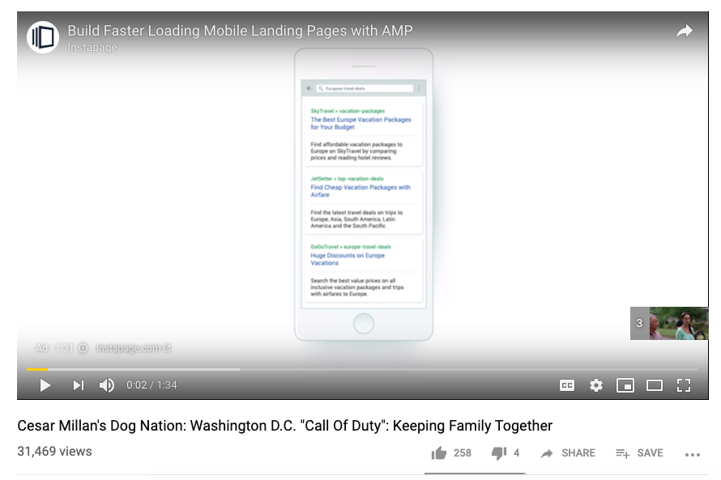
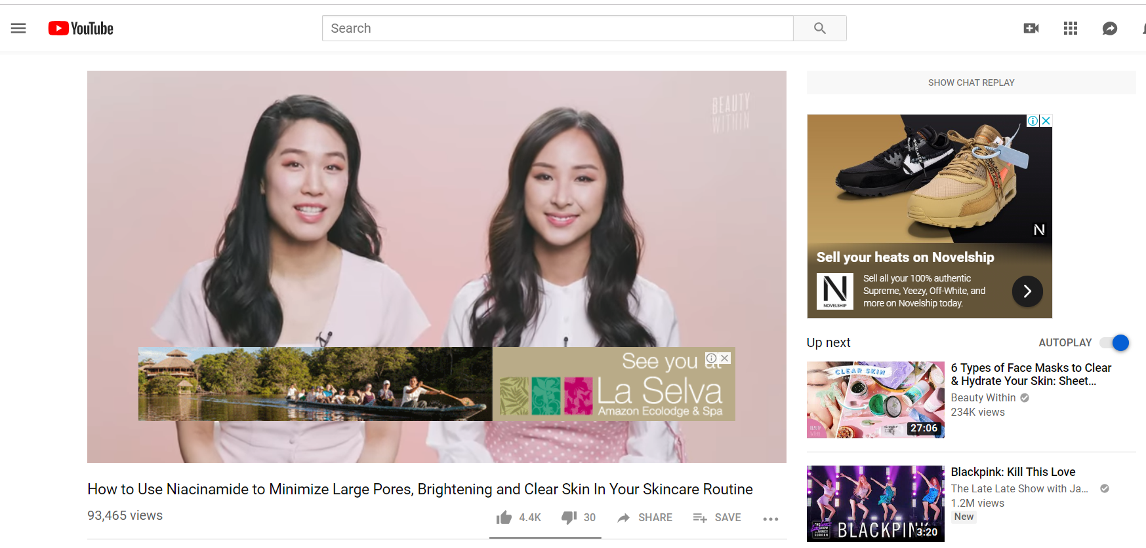
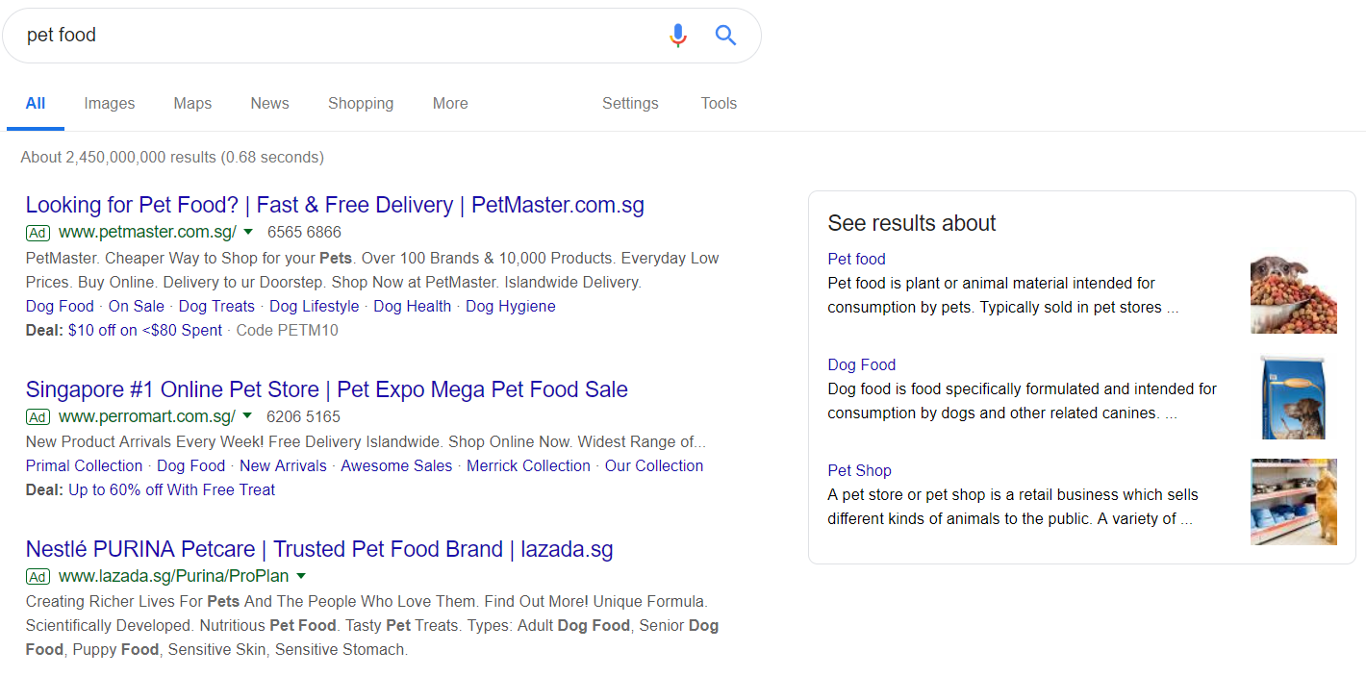
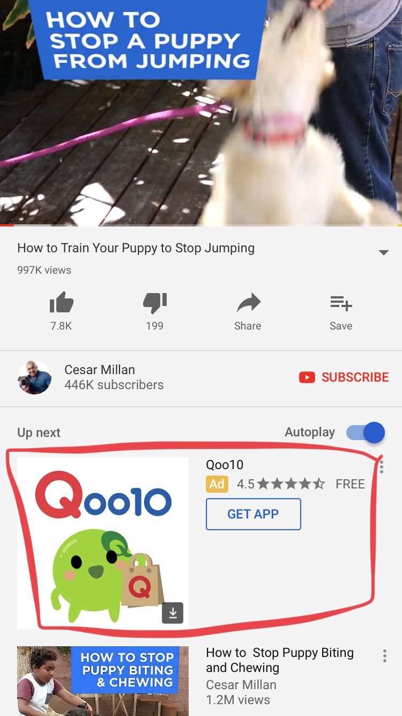
See
Think
Do
Care
Customers in the See & Think stage
Purpose
Raising brand and product awareness for the new Royal Canin brand.
Customers
We will use affinity customers and lookalike customers to reach potential customers.
Their attributes and interests are as follows:
Demographic: Millennials (age 20-36)
Geography: Singapore
Affinity: Pet lovers, pet owners
Topic pages: pet owners/lovers community, animal welfare pages, pet video channel followers
Strategy
A blend of video ad + content to draw the audience in. Display and native ads will complement by directing traffic to the video or the website to find out about the full story.
Image ad strategy
A mix of browser and mobile (because our users are mobile-first) image ads to direct people to the video and website.
CTA: go to Royal Canin website or video channel to see the full story
Desktop browser view of native ads
Mobile view of native ads
Video ad strategy:
What: A mix of skippable, un-skippable and out-stream short form videos that is strung together like a mini series that tells the journey of owning a pet from the pet’s POV. In it, there can be subtle product placements and the video can end with Royal Canin’s brand message.
Why: draw the audience in to the brand message of how we are there every step of the way. Compelling storyline to attract the audience to find out more about the brand.
Where: before pet care videos, on pet care websites/blogs/review sites
CTA: go to Royal Canin website to see the full story
Notes:
Speaker Note:
For video and display ad strategies in the See and Think stages, we are bringing brand awareness to the Affinity Audiences who are interested in pets-related topics such as how to care for their pet and what type of food to feed their pets which are important to our brand’s message. We are also targeting similar audiences who are millennials with pets to let them know the existence of Royal Canin and what we can provide for their pets.
We will use Short-form video and Outstream video ads to tell the story of owning a pet from the pet’s POV and tie it in with our core message “We are here to make owning a pet easy for you”. We choose to use video ads for promoting brand awareness as it is the most compelling way to narrate the storyline from different pet’s POV.
We aim to reach these potential customers where they are on the web such as before pet care videos, on pet care websites/blogs/review sites and increase Royal Canin’s visibility with affinity audiences and similar audiences to build a better recall rate for our brand and to increase brand interactions with our potential customers.

Slide 12
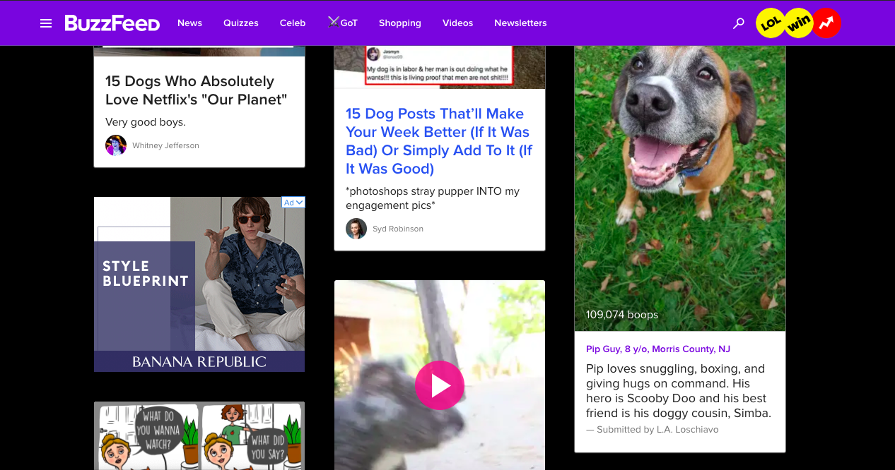
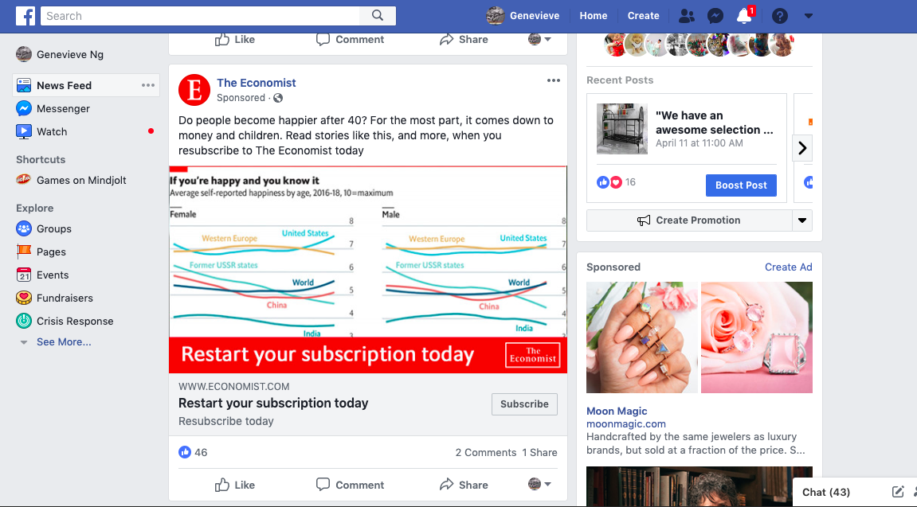
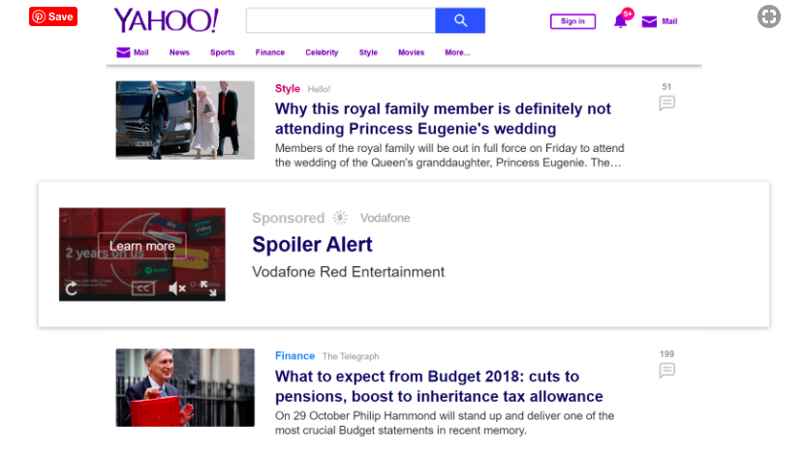

See
Think
Do
Care
Customers in the Do & Care stage
Purpose
Increase conversion and user acquisition
Customers
We will use in-market audiences and re-marketing audience to increase chances of purchase.
In Market Audience – those actively research on Royal Canin products with potential intent to buy
Re-marketing – those who have engaged with our website but did not buy
Strategy
A blend of customised image, text and native ads to help customers make the purchase. We will share:
Benefits of products
Promotions and offers
Where they can buy the product
Where they can share their reviews
In all, the common CTA is to direct traffic to Royal Canin’s ecommerce website or app to make the purchase.
Image ad strategy
A mix of browser and mobile ads that offers promotions & discounts. E.g. Free Delivery
Native ad strategy
Sponsored articles and posts, or in-feed social ads that can talk about the benefits of Royal Canin’s product.
Desktop browser view of native ads
Mobile view of native ads
Text ad strategy
E.g.
Pet Food Sale www.royalcanin.com.sg Free Delivery!
Notes:
Speaker Note:
In the Do and Care stages, we want to encourage potential customers or repeat customers to take an action which is to buy a product from us. These are In-market Audiences who have been actively researching pet-related products or customers who have visited Royal Canin’s website with intent to buy. We want to remarket and retarget them as they are already engaged with our website but did not convert.
We will use Text ads, Image ads and native ad strategy in our “direct response” campaigns to encourage customers to purchase by offering promotions and discounts. Together with programmatic marketing, our native ads will show up when potential customers browse other websites to retarget them. With that in mind, in our retargeting customize ads, we will highlight distinct offers that the customer can take advantage of, provide discount information such as free delivery to help the customer decide whether to act.

Slide 13

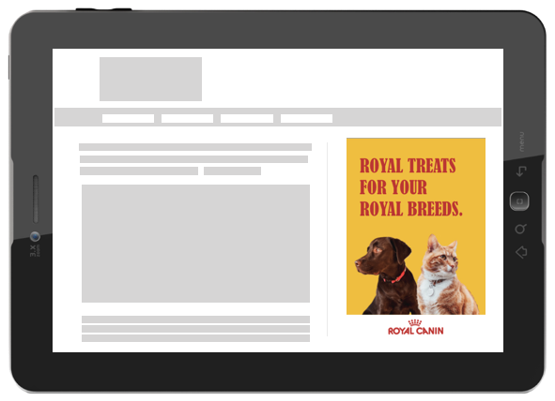
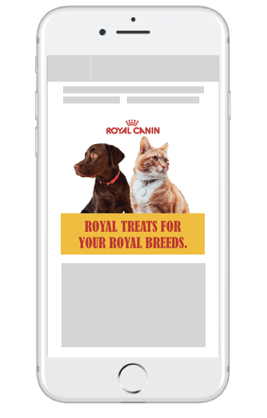
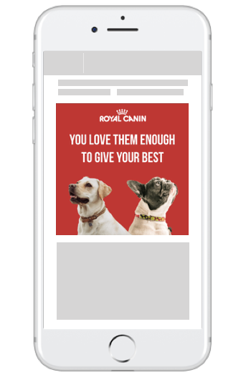
Programmatic Strategy – See (Ad Creative)
Programmatic Strategy – See (Ad Creative)
Programmatic Strategy – See, Think
TA: MILLENIAL PET OWNERS (MICA & MARK)
OBJECTIVE: RAISING ROYAL CANIN’S BRAND AWARENESS
CUSTOMER JOURNEY STAGE | SEE | THINK
THOUGHTS | What should I prepare when owning a pet? What makes a happy pet? | What should I feed my pet? How to ensure a nutritious diet for my pet? What are the pet food brands available in Singapore?
DIGITAL SIGNALS | Audience Social behavior (ie. posts liked, favourited and shared) –Royal Canin can curate relevant content on pets well being and tips on owning pets Environment Device information – Royal Canin can use this information to create ads customised to the devices used and operating systems Media Search and web history (ie. Keywords used, websites visited) – Royal Canin can craft messages suited to audience’s intent to find out more about how to make their pets happy | Audience Social behavior (ie. posts liked, favourited and shared) –Royal Canin can tap on this signal to find out the popular pet food brands that audience are following Environment Device information – Royal Canin can create ads for different devices and operating systems to optimise the marketing efforts and reach out to more audience Media Search and web history (ie. Keywords used, websites visited) – Royal Canin can craft messages on their tailormade nutrition for their pets
MESSAGE | YOU LOVE THEM ENOUGH TO GIVE YOUR BEST. The use of emotive messaging will display Royal Canin’s understanding of pet owners to provide the best to their pets. This message aims to promote Royal Canin’s brand as one that knows the needs of pet owners. | TAILORED FOR YOUR ROYAL BABIES. ROYAL TREATS FOR ROYAL BREEDS. This message aims to communicate the USP of Royal Canin – tailormade nutrition for pets. The term “babies” is used to bring connection that pets are more than just pets, but seen as “kids”.
Dynamic Ad Creative - See
Tailored for Royal Canin’s customers.
Messages can be targeted specifically to the audiences at different stages of the intent based on the media signals (ie. search history).
Dynamic Creative Ad - Think
Royal Canin love their customers to give them the best.
The media and environment signals gathered will enable Royal Canin to develop creatives in different sizes and formats that are optimized for viewing on various devices and web pages browsed most by Royal Canin’s customers.
Integrating programmatic, we will be able to bid for the ad spaces available on the web pages to reach the right audiences.

Slide 14
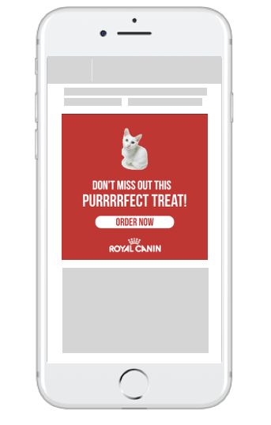
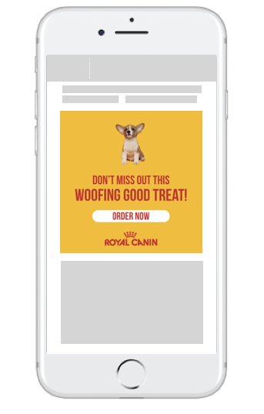

Programmatic Campaign – Care (Ad Creatives)
Programmatic Campaign – Do (Ad Creatives)
Programmatic Strategy – Do, Care
TA: MILLENIAL PET OWNDERS (MICA & MARK)
OBJECTIVE: ACQUISITION OF ROYAL CANIN’S PRODUCTS AND BRAND
CUSTOMER JOURNEY STAGE | DO | CARE
THOUGHTS | Where can I buy Royal Canin’s products? How much does Royal Canin’s pet food cost? What are the available promotion for pet food? | How can I let more people know about Royal Canin’s products? How can I find out more about Royal Canin’s updates?
DIGITAL SIGNALS | Audience Social behavior (ie. purchase history) – Royal Canin will be able to understand types of promotions that will attract audience to purchase and also identify the breed of pets owned by each individual Environment Geolocation – Helps Royal Canin identify the proximity to the store and the areas that users are from – accessibility and ease to purchase Royal Canin’s products Media Search and web history (ie. Keywords used, websites visited) – Royal Canin can craft messages to match audience’s intent to purchase pet food with promotions | Audience Social behavior (ie. posts shared) – Reviews of customers to share their experiences Purchase history – Understand customers behavior; if repeated purchases were made
MESSAGE | DON’T MISS OUT THIS WOOFING GREAT TREAT! DON’T MISS OUT THIS PURRRRFECT TREAT! To encourage action, the message to audience should provide an incentive for audience. This could include a promo code for first time customers and/or special flash sales. | WE’D LOVE TO HEAR FROM YOU. SHARE YOUR STORY WITH US.
Dynamic Ad Creative - Do
Dynamic Ad Creative - Care
Never miss out a good deal with Royal Canin.
Royal Canin will be able to customize messages to different groups of pet owners; for example, cat and dog owners. The media signals will vary for the two different – keywords searched and content browsed will be different as the needs of cats and dogs are different. Programmatic will enable Royal Canin to target specific groups of customers through setting up keywords and demographics.

Slide 15
Strategies for Collaboration & Innovation
For the integrated marketing campaign to be successful, collaboration and innovation is necessary.
COLLABORATION (Engaging others across functions and organizational structures) | INNOVATION (Applying fresh ideas and taking calculated risks)
Collaboration across different functions and teams in Royal Canin for a successful execution of the integrated marketing plan. Mobile – collaboration with web developer and IT team The expertise of the web developers and IT team can be tapped on to develop the mobile responsive web site and native mobile app. UI and UX designers can also design the interface of the website and mobile app is user friendly to provide a seamless experience for users from mobile to desktop and vice versa. Video – collaboration with creative and media teams Video production can be done in collaboration with the creative and media teams for scripting and storyboarding – communicating the key messages to the target audience creatively and engaging the audiences with viral and fresh content. Search and Programmatic – collaboration with data analytics, creative and media teams Collaboration with the data analytics team to determine digital signals of the target audience, then work closely with the creative team to create ads that are personalized for customers at different stages of the customer journey. The media team can also be involved to develop an effective programmatic strategy so that the messages can reach out to more audiences and reap better performance. | Innovation is vital for the integrated marketing plan for Royal Canin to stand out from the other brands and capture greater market share. Mobile The creation of a brand new native app is an innovation for Royal Canin. Besides selling the brand’s products, it also provide value-added services that will engage millennial pet owners through entertainment (eg. PeTube) and new technology (eg. PetAid uses VR). Video Videos on owning pets and education on pet nutrition are widely available on the Internet. Fresh ideas for videos are necessary to deliver content that millennial pet owners can be engaged and connected deeply with the Royal Canin brand.

